Slide 1
Android Application – Requirement Tracker
CS673 Group 3:
Iteration 1
3/2/2016
Danny Chiu Macuei Mathiang
Brian Kabuye Ayodele Awoleye
ChihYung Wu Josh Wildey

Slide 2
Team Members
Danny Chiu
Team Leader|Requirement Leader|QA Leader
Brian Kabuye
Implementation Leader|Developer
ChihYung Wu
Design Leader|Developer
Macuei Mathiang
Security Leader|Tester
Ayodele Awoleye
Configuration Leader|Tester
Josh Wildey
Environment & Integration Leader|Tester

Slide 3
Main Objective
We want to create a functional Android application of the Requirement Tracker tool that is on the 3Blueprints website.

Slide 4
Essential Features
User Login Screen
Able to login/create an user account.
View list of different projects for each account
Logging in should bring user to main menu where all the projects associated with account will be listed.
Option to create and modify user stories.
Able to create new user story.
Able to edit/delete each data field.

Slide 5
Iteration 1
Main Objectives
User Login Interface
Backend Development for authentication

Slide 6
User Interface
Requirements
Develop a User Interface that will allow the user to login

Slide 7
Requirements Analysis
User Stories
As a designer, I want user to be prompted with selection screen to login if they have an existing account or sign up for a new account on the app

Slide 8
Tasks
UI Tasks
Create background
create ‘Sign Up’/’Sign In’ buttons
create Sign Up screen
Layout/positioning of buttons
Code Tasks
Code actions associated with buttons
code screen transitions
code authentication with backend

Slide 9
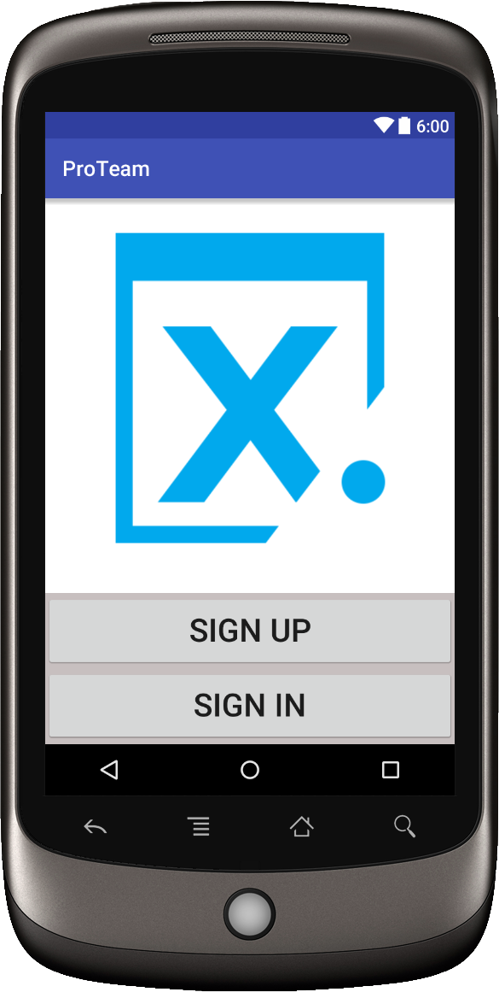
User Interface Layout

Slide 10
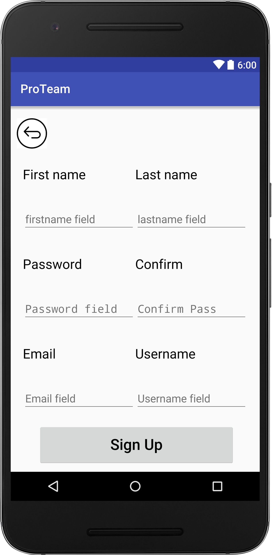
Actual User Interface of Iteration 1

Slide 11
User Interface Accomplishments
Start screen with Sign In/Sign Out buttons
Sign Up screen transitions correctly when Sign Up button is pressed
Currently working on Authentication

Slide 12
Backend Development
Requirements
Login Authentication added to existing Django Project

Slide 13
Requirements Analysis
User Stories
As a developer, I want to receive a valid token if a user is successfully authenticated so that the user can use that token to complete desired actions beyond the login

Slide 14
Tasks
Add RESTful authentication to existing Django code base
Add RESTful view to return authentication token with valid login credentials
Add sample projects to test token authentication
Associate token that was given out to the user that requested it

Slide 15
Understanding the Current System
Setting up the environment
When setting up, I was using different Django, python versions, updated deprecated functions
Walk through tutorials on setting up simple Django servers/REST APIs
Start trying to add code to existing code base (Trial/error based learning) or possibly start refactoring some existing code
Read, Read, Read… (code, tutorials, framework documentation)

Slide 16
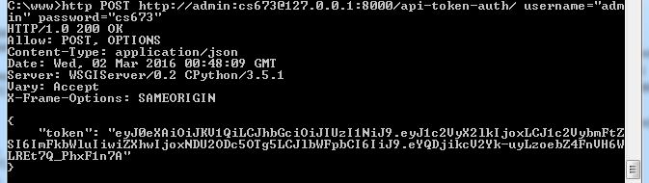
Testing
Using httpie package to do simple http command requests

Slide 17
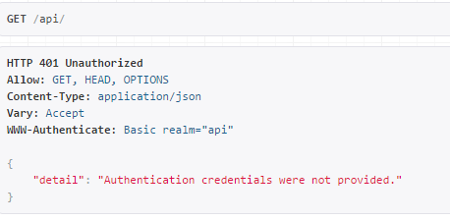
Testing
Using REST framework web interface to verify RESTful views

Slide 18
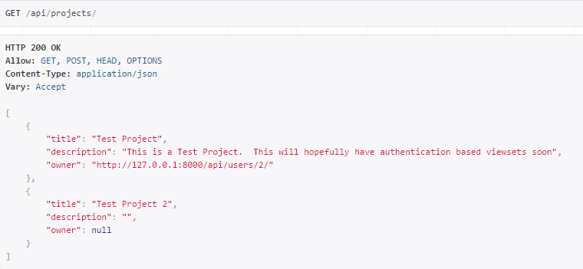
Testing
Using REST framework web interface to verify RESTful views

Slide 19
Accomplishments
Added RESTful authentication framework
Using Rest Framework JWT (JSON Web Token)
Added projects for token authentications tests
Add SSL layer to existing Django server
Currently returning authentication token

